Slide 1
DevOps Activities

Slide 2




Planned DevOps Activities

Slide 3
Agenda
1
AWS service management activity
2
Project Source code management​
3
Code Quality gate Integration
4
Jenkins – CI / CD
5
Runbook management
6
Terraform Development

Slide 4
Agenda
7
Cost management & Optimization activity
8
Alert and Monitoring
9
Jira and GitHub integration
10
Change Advisory Board (CAB) and Release Management
11
Business approval Integration for deployments

Slide 5
AWS user management activity

Slide 6
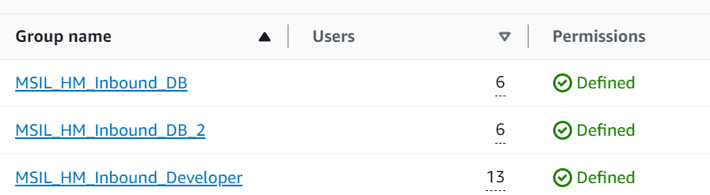
1. AWS user groups
IAM users are grouped based on permission requirements.
2. Customer managed Policies integration
All the custom policies are integrated to a single customer managed policies such as MSILInboundDBPolicy, MSILInboundDeveloperPolicy.

Slide 7
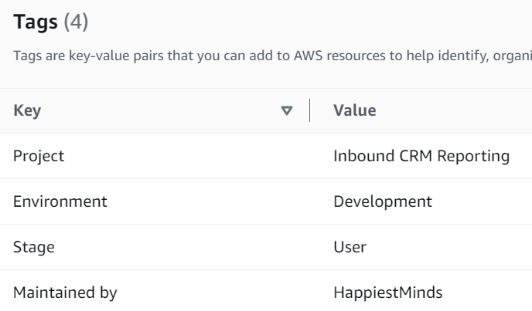
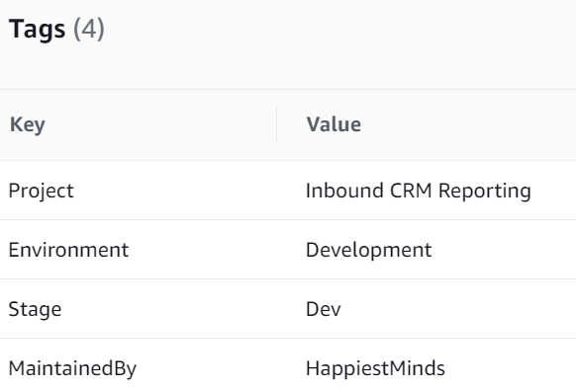
3. Adhoc activities AWS user groups
IAM users are grouped based on permission requirements.
Activities such as user creation, policy updation, MFA, password updation, CLI access are handled.
4. Tagging
Tagging is done for the IAM users and the aws services.
Shell scripts are prepared to tag the users associated with the text file containing the list of users.
Similarly, tag for resources are create with the script with the required tags.

Slide 8
Project Source code management

Slide 9
Git repository details
https://github.com/MSILDigital
MSILDigital
mi-inbound-web
mi-inbound-db
mi-inbound-foundation
mi-inbound-platform

Slide 10
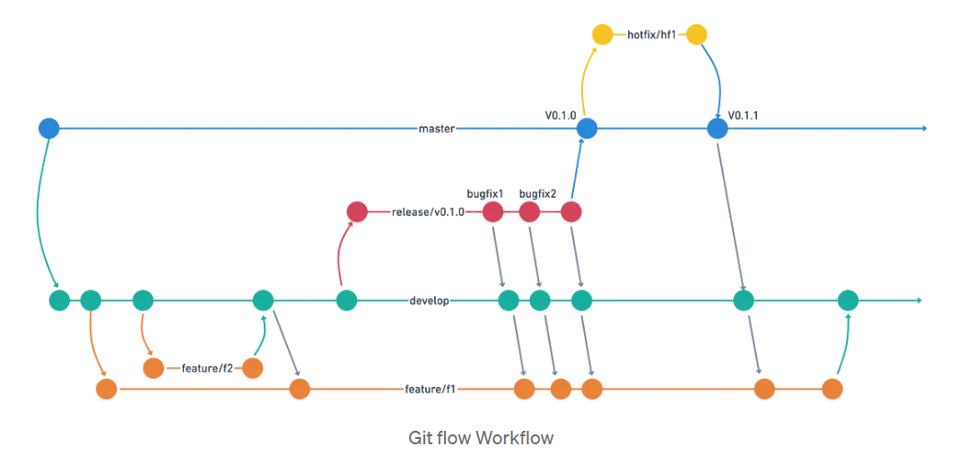
2. Git branching strategy

Slide 11
Code Quality gate Integration Quality

Slide 12
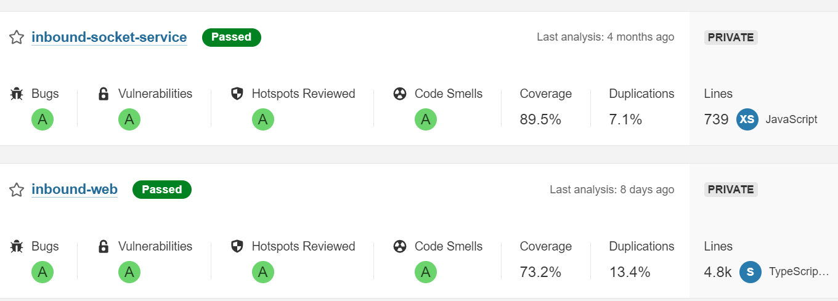
MSIL Sonarqube
Sonarqube is integrated to get the reports on the code quality.
https://sonarqube.msildevopsportal.co.in/projects?sort=analysis_date

Slide 13
Jenkins – CI / CD

Slide 14
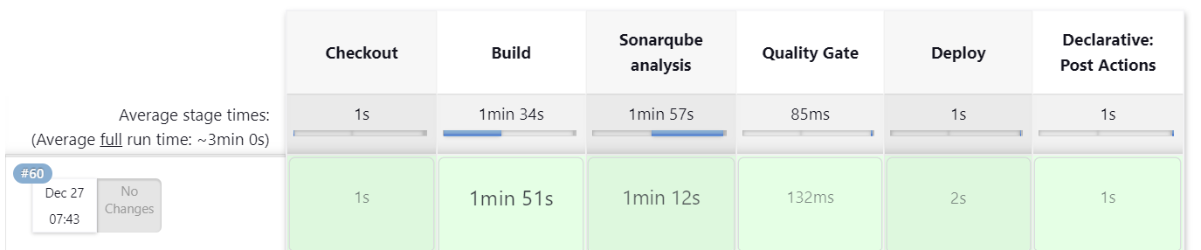
Pipeline is created for the automation purpose which will include stages such as Inbound-Report consists
of multiple jobs such as, mi-inbound-platform-job, mi-inbound-web-job, mi-inbound-db-job and terraform.
https://jenkins.msildevopsportal.co.in/job/Inbound-Report/
1. mi-inbound-web-job
This job is for the web deployments.
The job consists of the stages such as checkout, build, sonarqube analysis, quality gate, deploy and post build activity for the notification.
2. mi-inbound-platform-job
This job is for the platform deployments.
The job consists of the stages such as checkout, build, sonarqube analysis, quality gate, deploy and post build activity for the notification.

Slide 15
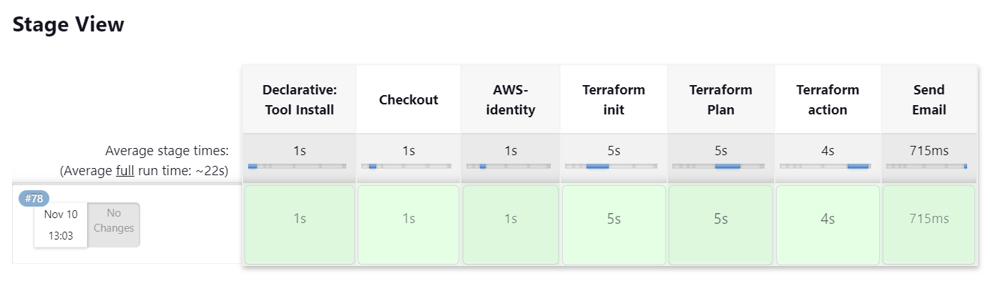
3. mi-inbound-db-job
This job is for the db deployments.
The job consists of the stages such as checkout, run shell script and post build activity for the notification.
4. Terraform
Pipeline is created for the terraform automation purpose which will include stages such as declarative tool install, checkout, AWS identity, terraform init, terraform plan, terraform action and notification.

Slide 16
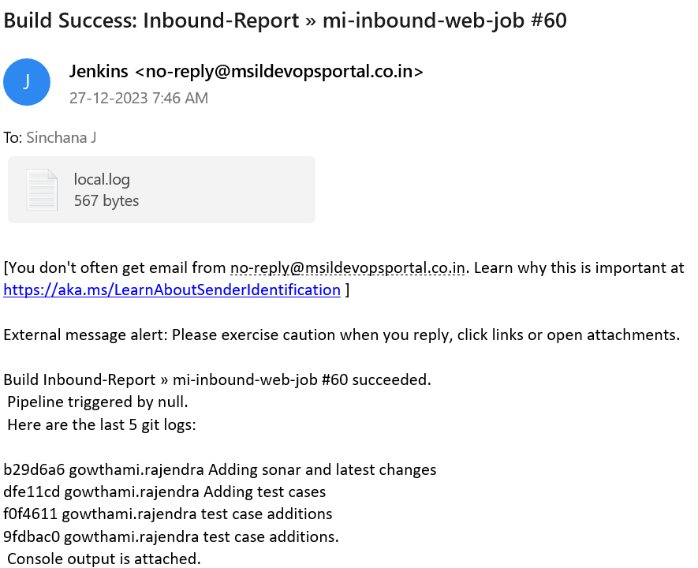
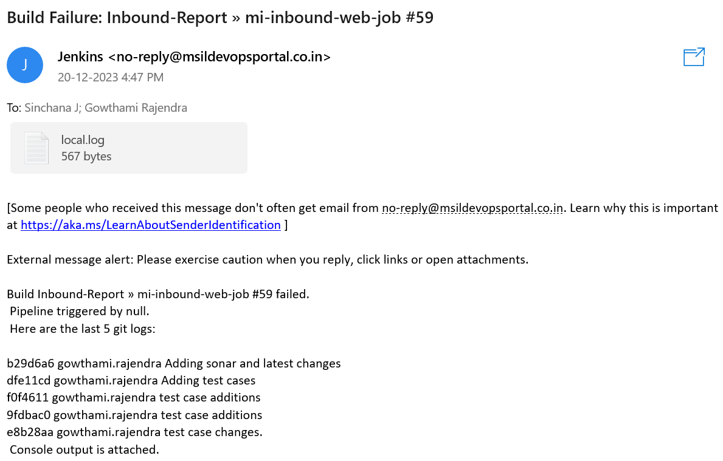
Post build action
The result of the pipeline will be received in the form of mail which contains the details such as,
In the post build action, the details of the job will be mailed to the members which includes the following points,
Build status
Job number
Last 5 git log details
Log file

Slide 17
Build Triggers
GitHub trigger
The pipeline will be triggered whenever changes are pushed to the specified git branch by enabling GitHub hook trigger for GITScm polling.
In the post build action, the details of the job will be mailed to the members which includes the following points
2. Build Periodically
The pipeline will be triggered periodically. Cronjob is set in the build trigger section to run the pipeline on a particular date and time

Slide 18
Runbook management

Slide 19
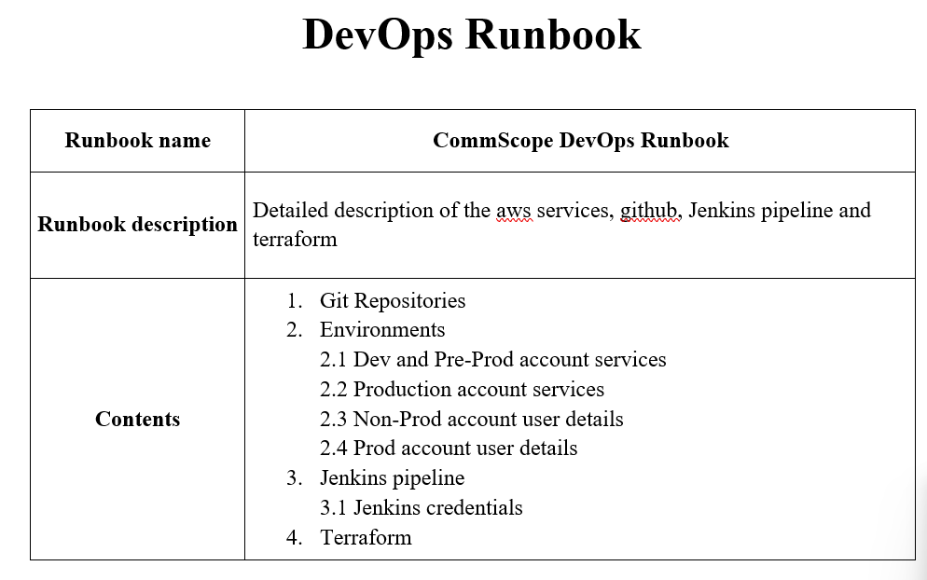
https://github.com/MSILDigital/mi-inbound-foundation/tree/dev
Runbook is prepared which includes all the details related to
Git Repositories
AWS Environments details and services used
AWS account user details
Jenkins pipeline
Terraform
The Runbook is updated periodically and stored in mi-inbound-foundation repository.

Slide 20
Terraform Development

Slide 21
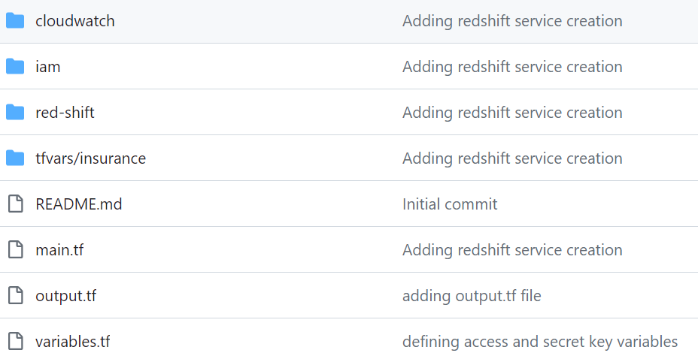
Terraform is used for the automation of creation of
services in aws
.tf files are created with the required
configurations for the creation of the AWS
services such as,
IAM users, policies and role
S3
Cloudfront
Redshift
VPC
Kinesis
Cloudwatch
Kinesis
Simple Notification service
AWS Secret manager
AWS DMS
Infrastructure creation is automated by
integrating terraform with Jenkins.

Slide 22
Cost management & Optimization activity

Slide 23
1. Scheduled pause and resume of the redshift cluster
Pause and resume scheduled are integrated for the redshift clusters to optimize the usage and reduce the cost.
The clusters will be paused for the weekends, i.e, pause on Friday evening and resume on Monday morning.
If necessary, the cluster can be resumed manually.
2. Cost allocation tags
Cost allocation tags are used to get the detailed billing based on the tags associated with the services.
The bill generated will be stored in the s3 bucket.

Slide 24
Alert and Monitoring

Slide 25
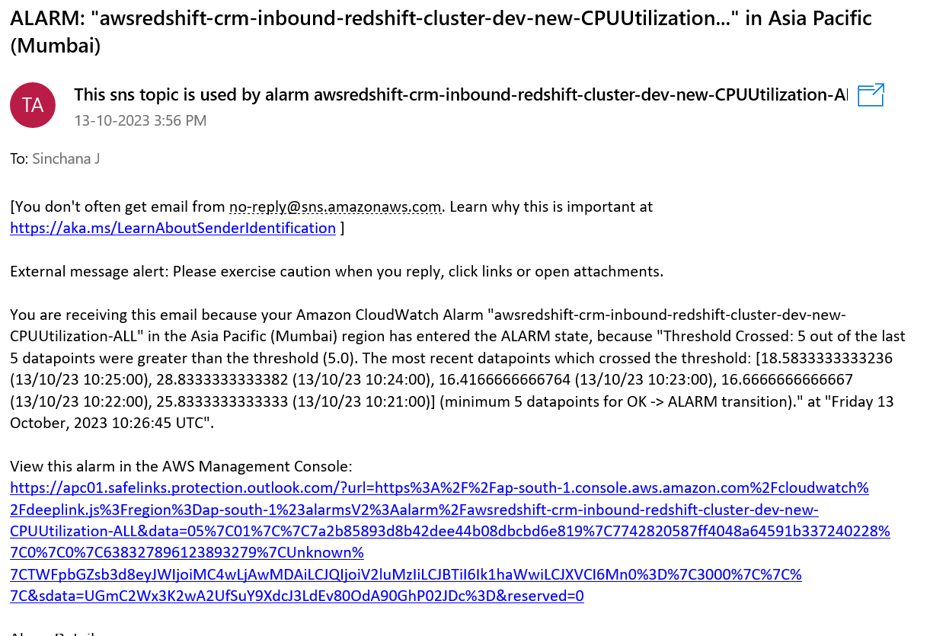
Monitoring of resources are done using cloudwatch alarms.
The alarms triggers the SNS and alert is sent through the mail.

Slide 26
Jira and GitHub integration

Slide 27
Integrating of jira with github to automate creation of git branch for the respective stories.
Jira Github smart commits to link the code changes in github with jira using special commit messages.
Jira github webhook
- Synchronized comments in jira and github.
- Jira status updation based on the status of related github pull request or commit.
- Automated jira issue link to github pull request or commits.

Slide 28
Change Advisory Board (CAB) and Release Management

Slide 29
Business approval Integration for deployments

Slide 30
lingesh.m@happiestminds.com
sinchana.j@happiestminds.com

